Slide 1
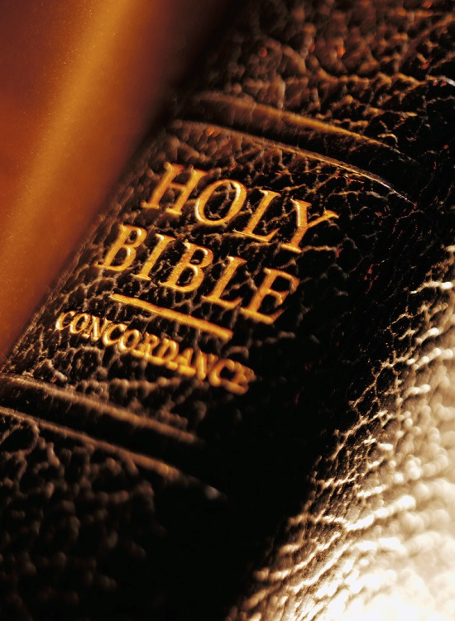
Expository
Excerpts
From Acts 2
(PART 1; Acts 2:1-13)
All Verses Are From The NKJV Unless Noted

Slide 2




ACTS 2
Pivotal Chapter
  From expecting the kingdom (Matt. 6:10; cf. Mk. 9:1; 14:24, 25; Lk. 22:29, 30; 23:42, 51)
  To seeing and entering the kingdom (Jn. 3:3, 5; Acts 8:12; 1 Cor. 6:9-11; Acts 28:31; Rom. 14:17; Col. 1:13; 4:11; 2 Thess. 1:5; Rev. 1:9; 12:10)

Slide 3
ACTS 2
Pivotal Chapter
Fulfillment of prophecy (Joel 2:28-32; Dan. 7:13, 14; 2:44)
Beginning of the church of Christ (Acts 2:47; 1 Cor. 12:13)
Terms of entrance given (Acts 2:21, 38)

Slide 4
1) God Keeps His Promises (2:1-11)
Promised (Lk. 24:46-49)
  46 Then He said to them, "Thus it is written, and thus it was necessary for the Christ to suffer and to rise from the dead the third day,
  47 "and that repentance and remission of sins should be preached in His name to all nations, beginning at Jerusalem.
  48 "And you are witnesses of these things.
  49 "Behold, I send the Promise of My Father upon you; but tarry in the city of Jerusalem until you are endued with power from on high."

Slide 5
1) God Keeps His Promises (2:1-11)
Promised (Jn. 16:18)
  “However, when He, the Spirit of truth, has come, He will guide you into all truth; for He will not speak on His own authority, but whatever He hears He will speak; and He will tell you things to come” (cf. Acts 1:4, 5)

Slide 6
The Baptism of The Holy Spirit?
Acts 2:1-4

Slide 7
Baptism of the Holy Spirit
Not necessarily equivalent to “being filled with the Spirit”
  John was “filled with the Spirit” and spoke of Holy Spirit baptism as something yet to happen (Lk. 1:13-15; 3:16)
Administer by no man on earth
  John could not (Lk. 3:15, 16)
  Apostles and preachers could not (Acts 8:14-16; 10:34-46; 11:15, 16)
  Jesus alone could (Jn. 1:33, 34; Acts 2:33)

Slide 8
Baptism of the Holy Spirit
Did not exclude the need to be baptized in water to be saved (Acts 10:47, 48)
Did not happen in water baptism (ibid.)
Happened infrequently – only twice
(Acts 2; 10)
  ACTS 11:15 “And as I began to speak, the Holy Spirit fell upon them, as upon us at the beginning.”
Gentiles
Apostles
WHEN?
LUKE 24:47

Slide 9
Baptism of the Holy Spirit
Was not something obeyed (Acts 1:4, 5)
Was not in effect when Paul wrote the letter to the Ephesians
  “There is one body and one Spirit, just as you were called in one hope of your calling; one Lord, one faith, one baptism” (Eph. 4:4, 5)
  The Ephesians were never baptized with the Holy Spirit but only with water (Acts 19:5, Eph. 5:26; 2:6; cf. Col. 2:12)

Slide 10
Speaking In Tongues?
???
Acts 2:1-4

Slide 11
Speaking in Tongues
One of nine gifts given by the Holy Spirit
(1 Cor. 12:7-11)
Beneficial to the church only if interpreted
(1 Cor. 14:5; 19)
  Without “understanding” is like speaking in the air (14:9)
  Were able to be interpreted (14:27, 28)
A temporary gift (1 Cor. 12:31; 13:8-13)
Has always been speaking intelligent words in another language (14:10, 11)

Slide 12
Speaking in Tongues
Apostles
Multitude
Filled with Holy Spirit (2:4)
Speak with other tongues (2:4)
Confused (2:6)
Heard in own language (2:6, 8, 11)
“Tongues” Equal “Languages”

Slide 13
God keeps his promises!

Slide 14
When God Promises:
To raise the dead…
  He will (Acts 24:15)
To judge the living and the dead…
  He will (Acts 10:42; 2 Tim. 4:1)
To destroy those who do not obey the gospel…
  He will (2 Thess. 1:8, 9; Rev. 20:12-15)
To save His people…
  He will (Rev. 21:5-7)

Slide 15
2) Man’s Slow Heart (2:12, 13)
Some amazed and perplexed…others mock
Should realize that men are sometimes slow to recognize the power of God
Some will run to the absurd to quickly dismiss and deride the truth
  Tactic: slander the messenger (1 Kin. 18:17; Matt. 9:34; 11:19; Acts 24:5)
  Tactic: mock the messenger, “And when they heard of the resurrection of the dead, some mocked, while others said, ‘We will hear you again on this matter’” (Acts 17:32; cf. Heb. 11:36)

Slide 16
2) Man’s Slow Heart (2:12, 13)
Some amazed and perplexed…others mock
Should realize that men are sometimes slow to recognize the power of God
Some will run to the absurd to quickly dismiss and deride the truth
Some will eventually repent and obey (Acts 6:7)
What will be your answer today?

Slide 17
THE SPIRIT’S ENDORSEMENT OF WATER BAPTISM
MATTHEW 28:19
"Go therefore and make disciples of all the nations,
in the name of the Father and of the Son and of the Holy Spirit”
BAPTIZING THEM
legislates
executes
reveals
JOHN 15:26
JOHN 16:13-15
JN. 3:5
1 COR. 12:13
1 COR. 6:11
SPEAKS FROM & GLORIFIES CHRIST
PROCEEDS FROM FATHER

